Slide 1
Chapter 10
Retrospective on Unit Testing

Slide 2
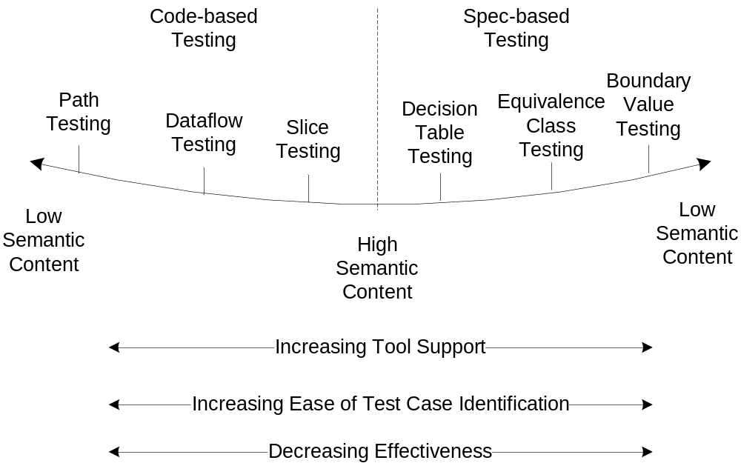
The Test Method Pendulum

Slide 3
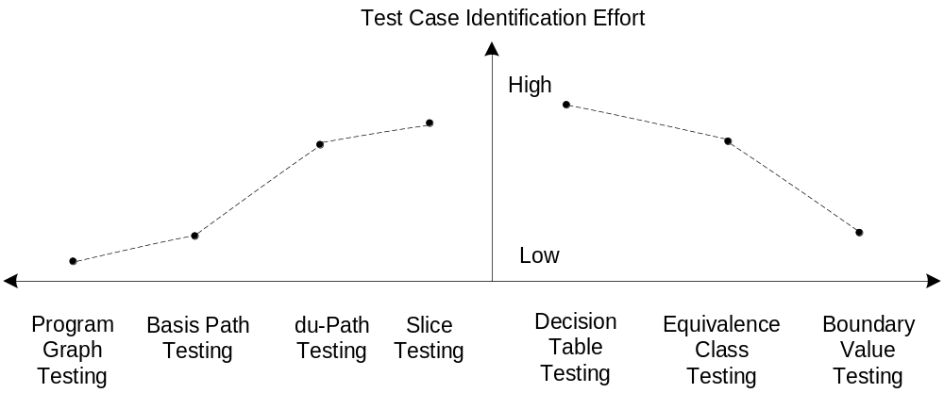
Test Case Identification Effort

Slide 4
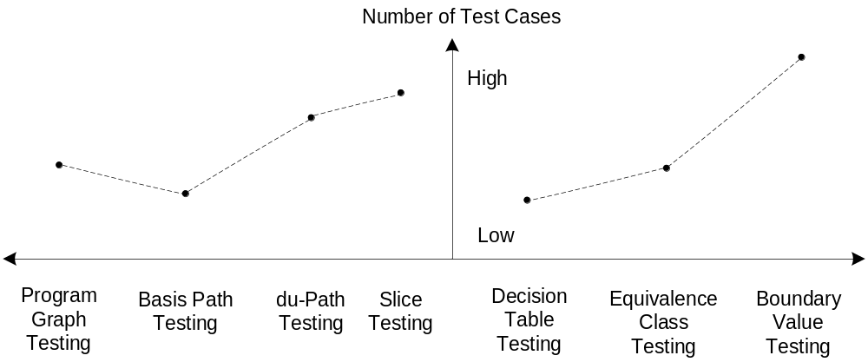
Number of Test Cases

Slide 5
Traversing the Code-Based Side
FORTRAN version of the Triangle Program
Problems with path testing
Basis path (McCabe) testing?
Dataflow testing
Slice testing
  80 topologically possible paths
  Only 11 feasible paths
  Cyclomatic complexity is 14
  Basis path testing? (expect 14 basis paths, but only 11 paths are feasible)
  Dataflow testing?
  Slice testing?

Slide 6
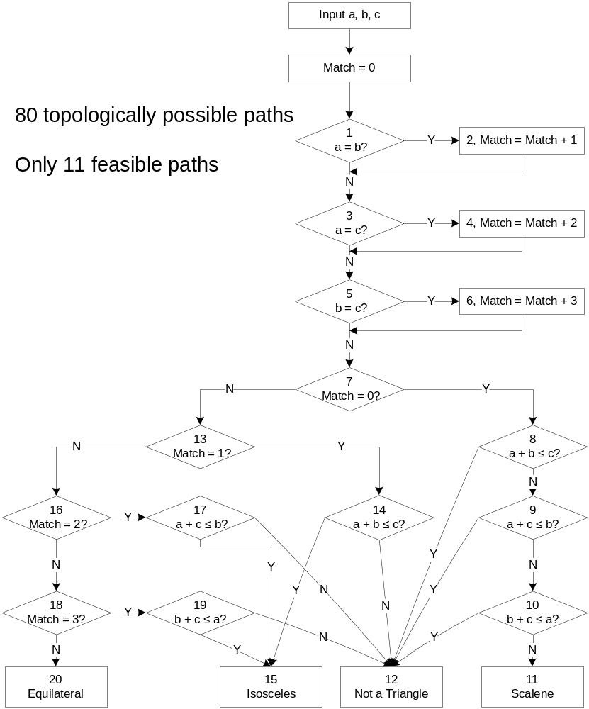
FORTRAN version of the Triangle Program

Slide 7
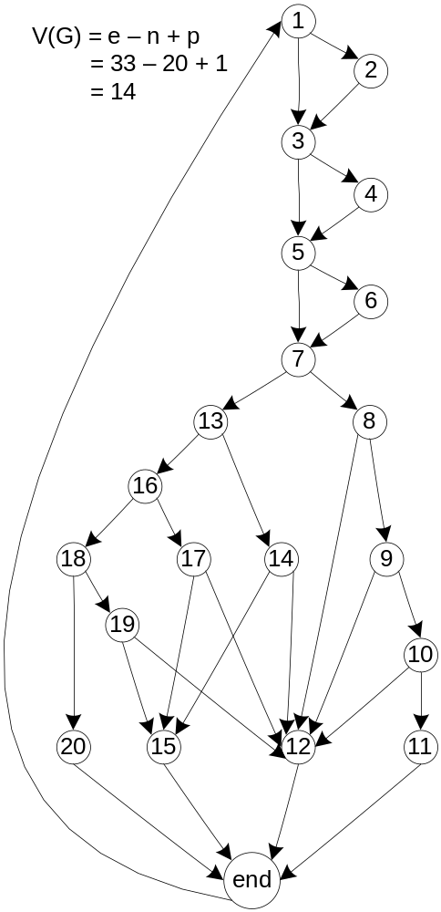
Program Graph (V(G) = 14)

Slide 8
Feasible Paths in the FORTRAN Version
Path | Node Sequence | Description
p1 | 1–2–3–4–5–6–7–13–16–18–20 | Equilateral
p2 | 1–3–5–6–7–13–16–18–19–15 | Isosceles (b = c)
p3 | 1–3–5–6–7–13–16–18–19–12 | Not a Triangle (b = c)
p4 | 1–3–4–5–7–13–16–17–15 | Isosceles (a = c)
p5 | 1–3–4–5–7–13–16–17–12 | Not a Triangle (a = c)
p6 | 1–2–3–5–7–13–14–15 | Isosceles (a = b)
p7 | 1–2–3–5–7–13–14–12 | Not a Triangle (a = b)
p8 | 1–3–5–7–8–12 | Not a Triangle (a + b ≤ c)
p9 | 1–3–5–7–8–9–12 | Not a Triangle (b + c ≤ a)
p10 | 1–3–5–7–8–9–10–12 | Not a Triangle (a + c ≤ b)
p11 | 1–3–5–7–8–9–10–11 | Scalene

Slide 9
Basis Path Testing?
Problematic!
V(G) = 14 suggests 14 basis paths
Only 11 logically feasible paths
“The Method” generates infeasible paths

Slide 10
Dataflow Testing?
Moving closer to “semantic reality”
Implications of the match variable
  FORTRAN style to reduce decisions
  Only values of match are 0, 1, 2, 3, and 6
The match variable has
  four definition nodes
  three computation uses
  four predicate uses
  28 define/use paths
The “side” variables a, b, and c have
  1 definition node
  9 use nodes
  9 definition-clear paths to test
37 dataflow test cases

Slide 11
Slice Testing?
Even closer to “semantic reality”
Make backward slices on
  scalene at node 11
  notATriangle at node 12
  isosceles at node 15
  equilateral at node 20

Slide 12
Slice Test Cases
3 test cases for S(scalene,11)
  (3, 4, 5)
  (4, 5, 3)
  (5, 3, 4)
1 test case for S(equilateral,20)
3 test cases for S(isosceles,15)
18 test cases for S(notATriangle, 12)
  six ways to fail the triangle test
  each way has three permutations, as for S(scalene, 11)
25 slice-based test cases
Compare with equivalence class test cases

Slide 13
Traversing the Specification-Based Side
Boundary Value Testing
  nominal values: 15 test cases
  worst case values: 125 test cases
Equivalence Class Testing
  11 equivalence classes
  correspond exactly to the 11 feasible paths
Decision Table Testing
  20 possible rules
  2 impossible rules
  provides insight into the match variable

Slide 14
Path Coverage of Nominal Boundary Values
Case | a | b | c | Expected | Path
1 | 100 | 100 | 1 | Isosceles | p6
2 | 100 | 100 | 2 | Isosceles | p6
3 | 100 | 100 | 100 | Equilateral | p1
4 | 100 | 100 | 199 | Isosceles | p6
5 | 100 | 100 | 200 | Not a Triangle | p7
6 | 100 | 1 | 100 | Isosceles | p4
7 | 100 | 2 | 100 | Isosceles | p4
8 | 100 | 100 | 100 | Equilateral | p1
9 | 100 | 199 | 100 | Isosceles | p4
10 | 100 | 200 | 100 | Not a Triangle | p5
11 | 1 | 100 | 100 | Isosceles | p2
12 | 2 | 100 | 100 | Isosceles | p2
13 | 100 | 100 | 100 | Equilateral | p1
14 | 199 | 100 | 100 | Isosceles | p2
15 | 200 | 100 | 100 | Not a Triangle | p3

Slide 15
Path Coverage of Nominal and Worst Case Boundary Value Test Cases
 | p1 | p2 | p3 | p4 | p5 | p6 | p7 | p8 | p9 | p10 | p11
Nominal | 3 | 3 | 1 | 3 | 1 | 3 | 1 | 0 | 0 | 0 | 0
Worst-case | 5 | 12 | 6 | 11 | 6 | 12 | 7 | 17 | 18 | 19 | 12

Slide 16
Equivalence Class Testing
Classes from Chapter 6:
  D1 = {<a, b, c> : a = b = c}
  D2 = {<a, b, c> : a = b, a ≠ c}
  D3 = {<a, b, c> : a = c, a ≠ b}
  D4 = {<a, b, c> : b = c, a ≠ b}
  D5 = {<a, b, c> : a ≠ b, a ≠ c, b ≠ c}
  D6 = {<a, b, c> : a > b + c}
  D7 = {<a, b, c> : b > a + c}
  D8 = {<a, b, c> : c > a + b}
  D9 = {<a, b, c> : a = b + c}
  D10 = {<a, b, c> : b = a + c}
  D11 = {<a, b, c> : c = a + b}
These classes will exactly execute the 11 feasible paths.

Slide 17
Decision Table Testing (continued)
c1. Match = | 0 |  |  |  | 1 |  |  |  | 2
c2. a + b <= c? | T | F! | F! | F | T | F! | F! | F | T | F! | F! | F
c3. a + c <= b? | F! | T | F! | F | F! | T | F! | F | F! | T | F! | F
c4. b + c <= a? | F! | F! | T | F | F! | F! | T | F | F! | F! | T | F
a1. Scalene |  |  |  | x
a2. Not a Triangle | x | x | x |  | x | x | x |  | x | x | x
a3. Isosceles |  |  |  |  |  |  |  | x |  |  |  | x
a4. Equilateral
a5. Impossible

Slide 18
(Extended Entry) Decision Table Testing
c1. Match = | 3 |  |  |  | 4 | 5 | 6
c2. a + b <= c? | T | F! | F! | F | -- | -- | T | F! | F! | F
c3. a + c <= b? | F! | T | F! | F | -- | -- | F! | T | F! | F
c4. b + c <= a? | F! | F! | T | F | -- | -- | F! | F! | T | F
a1. Scalene
a2. Not a Triangle | x | x | x |  |  |  | x | x | x
a3. Isosceles |  |  |  | x
a4. Equilateral |  |  |  |  |  |  |  |  |  | x
a5. Impossible |  |  |  |  | x | x

Slide 19
Notes on the EEDT
the “match” variable notes which two sides (if any) are equal
we are stuck with some reverse logic on the triangle inequalities
there is a typo in Table 10.4. In the rule where
  match = 1
  c2 and c3 are F!
  c4 = F is an isosceles triangle
In the rule before that, the two x entries say that something is both Not a Triangle and Isosceles. (Oppss!)

Slide 20
Redundancy Metrics Definitions
Given a test method M that generates m test cases and a coverage metric S that defines s test cases for n structural elements...
  The coverage of a methodology M with respect to a metric S, denoted C(M,S), is ratio of n to s.
  The redundancy of a methodology M with respect to a metric S, denoted R(M,S), is ratio of m to s.
  The net redundancy of a methodology M with respect to a metric S, denoted, NR(M,S) is ratio of m to n.

Slide 21
Redundancy Metrics for the Triangle Program
Method | m | n | s | C(M, S) = n/s | R(M, S) = m/s | NR(M, S) = m/n
Nominal | 15 | 7 | 11 | 0.64 | 1.36 | 2.14
Worst-case | 125 | 11 | 11 | 1 | 11.36 | 11.36
Goal | s | s | s | 1 | 1 | 1

Slide 22
Case Study
A hypothetical Insurance Premium Program computes the semi-annual car insurance premium based on two parameters: the policy holder's age and driving record:
Premium = BaseRate*ageMultiplier – safeDrivingReduction
The ageMultiplier is a function of the policy holder's age, and the safe driving reduction is given when the current points (assigned by traffic courts for moving violations) on the policy holder's driver's license are below an age-related cutoff. Policies are written for drivers in the age range of 16 to 100. Once a policy holder has 12 points, his/her driver's license is suspended (hence there is no need for insurance). The BaseRate changes from time to time; for this example, it is $500 for a semi-annual premium.

Slide 23
Insurance Premium Program Data
Age Range | Age Multiplier | Points Cutoff | Safe Driving Reduction
16<= age < 25 | 2.8 | 1 | 50
25<= age < 35 | 1.8 | 3 | 50
35<= age < 45 | 1.0 | 5 | 100
45<= age < 60 | 0.8 | 7 | 150
60<= age <= 100 | 1.5 | 5 | 200

Slide 24
Insurance Premium Program Calculations, Test Method Selection
Premium = BaseRate*ageMultiplier – safeDrivingReduction
ageMultiplier = F1(age) [from table]
safeDrivingReduction = F2(age, points) [from table]
age and safeDrivingReduction are physical variables, with a dependency in F2.
Boundary values for age: 16, 17, 54, 99, 100
Boundary values for safeDrivingReduction: 0, 1, 6, 11, 12
Robust values for age and safeDrivingReduction are not allowed by business rules.
Worst case BVA yields 25 test cases, and many gaps, some redundancy. Need something better.

Slide 25
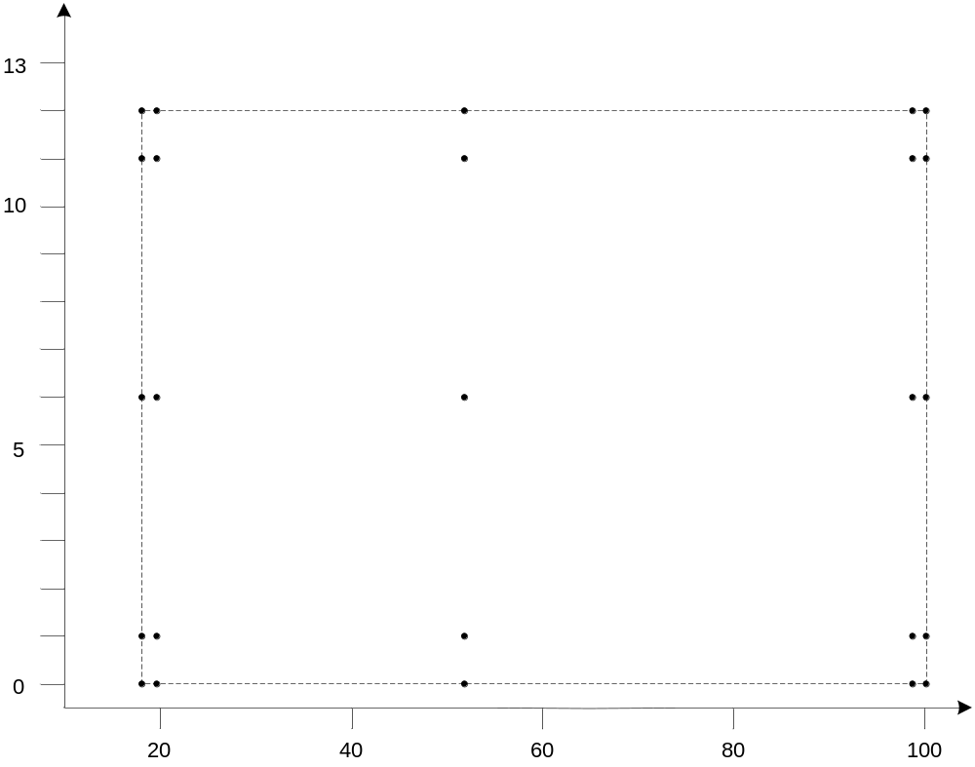
Worst Case Boundary Value Test Cases
(severe gaps!)

Slide 26
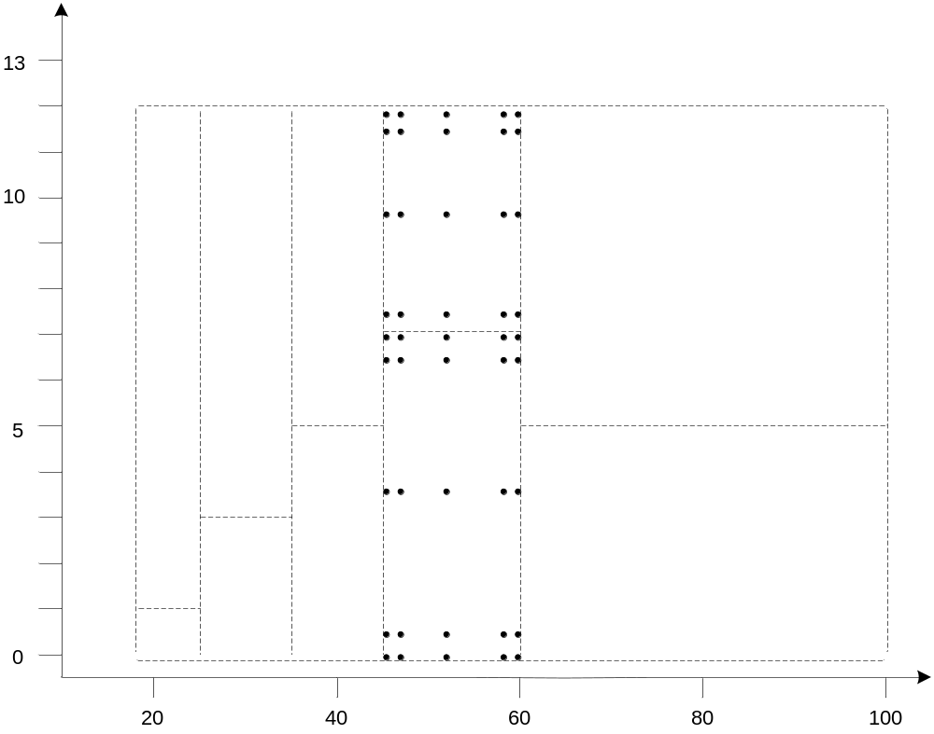
Closer Look At One Age Interval
(severe redundancy)

Slide 27
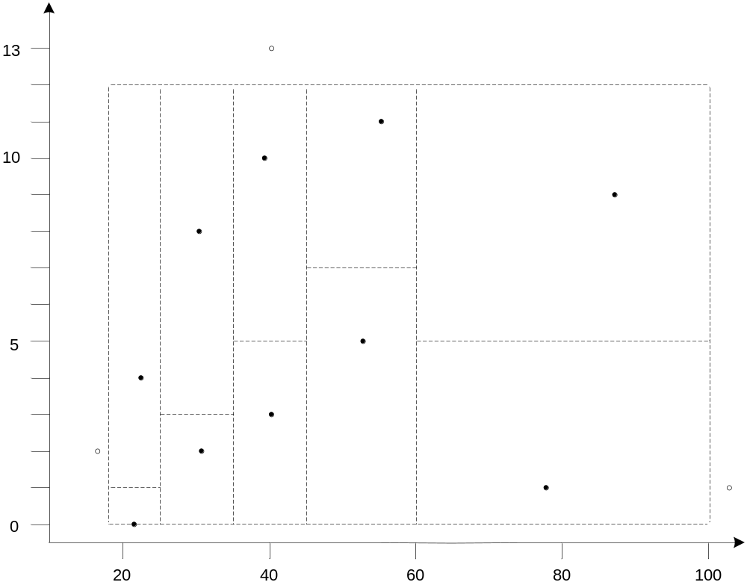
Weak and Robust Normal Equivalence Classes? (not much help)

Slide 28
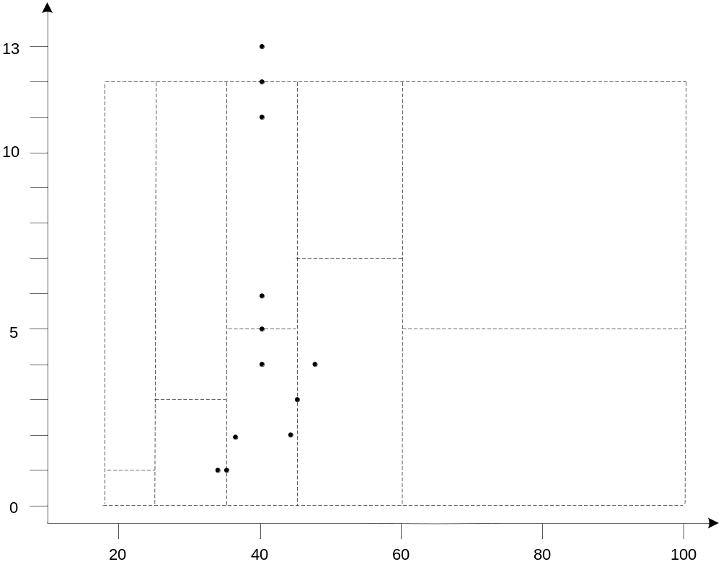
Hybrid Test Cases for One Age Class

Slide 29
Code-Based Testing for the Insurance Premium Program
(Source pseudo-code and program graph on next slide)
Cyclomatic complexity: V(G) = 11
There are 11 feasible paths.

Slide 30
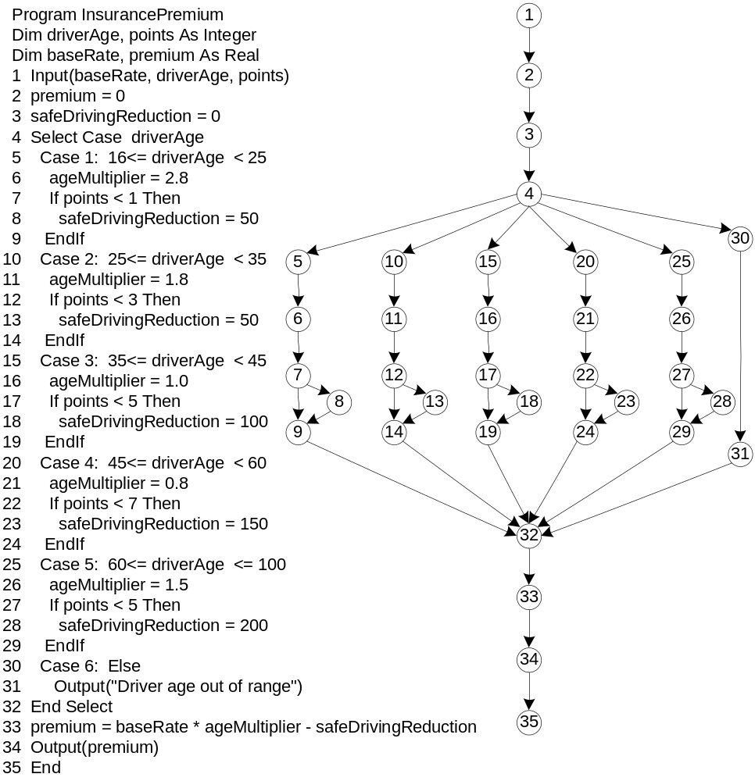

Slide 31
Paths in the Insurance Premium Program
Path | Node Sequence
p1 | 1-2-3-4-5-6-7-9-32-33-34-35
p2 | 1-2-3-4-5-6-7-8-9-32-33- 34-35
p3 | 1-2-3-4-10-11-12-14-32-33- 34-35
p4 | 1-2-3-4-10-11-12-13-14-32-33-34-35
p5 | 1-2-3-4-15-16-17-19-32-33-34-35
p6 | 1-2-3-4-15-16-17-18-19-32-33- 34-35
p7 | 1-2-3-4-20-21-22-24-32-33- 34-35
p8 | 1-2-3-4-20-21-22-23-24-32-33-34-35
p9 | 1-2-3-4-25-26-27-29-32-33-34-35
p10 | 1-2-3-4-25-26-27-28-29-32-33-34-35
p11 | 1-2-3-4-30-31-32-33-34-35

Slide 32
Path Coverage of Spec-Based Methods
 | Test Cases | Paths covered
Boundary value | 25 | p1, p2, p7, p8, p9, p10
Worst-case boundary value | 103 | p1, p2, p3, p4, p5, p6, p7, p8, p9, p10
Weak normal equivalence class | 10 | P1, p2, p3, p4, p5, p6, p7, p8, p9
Robust normal equivalence class | 12 | p1, p2, p3, p4, p5, p6, p7, p8, p9, p10, p11
Decision table | 12 | p1, p2, p3, p4, p5, p6, p7, p8, p9, p10, p11
Hybrid spec-based (extended to all age classes) | 32 | p1, p2, p3, p4, p5, p6, p7, p8, p9, p10, p11

